Slide 1

Project: A Japanese Study-Dictionary
Project Purpose
To develop a helpful application for Japanese language study
Goals
The user will be able to save and search for words and their definitions
The user will be able to assign words to groups and view all words in a group
The application will be easy/convenient to use
Notes:
1) Title

Slide 2
Andrew Resch – ReschAJ@mail.uc.edu
Advisor:
Fred Annexstein - fred.annexstein@uc.edu
Notes:
2) Names

Slide 3
Project Abstract
Many make the attempt to learn an additional language. And while not everyone succeeds, having effective learning tools can make the process much easier. This project is to make one such tool, with the app being tuned for studying the Japanese language.
The application will be developed for Android devices and will make use of a database for the user to save and retrieve words and their definitions. The user will be able to search for words they have saved using either the word or the definition.
Notes:
3) Project Abstract

Slide 4
User Stories
1) As a Japanese-language student, I want to record all the vocabulary words covered in class, so that if I forget a word, I can easily look it up.
2) As someone who is using media to study Japanese, I want to mark what books or shows a word is present in, so that I can recall the contexts that each word is used in.
3) As a Japanese-language learner, I want to track how many words I know, so that I have an estimate of my learning progress.
Notes:
4) User Stories and Design Diagrams

Slide 5
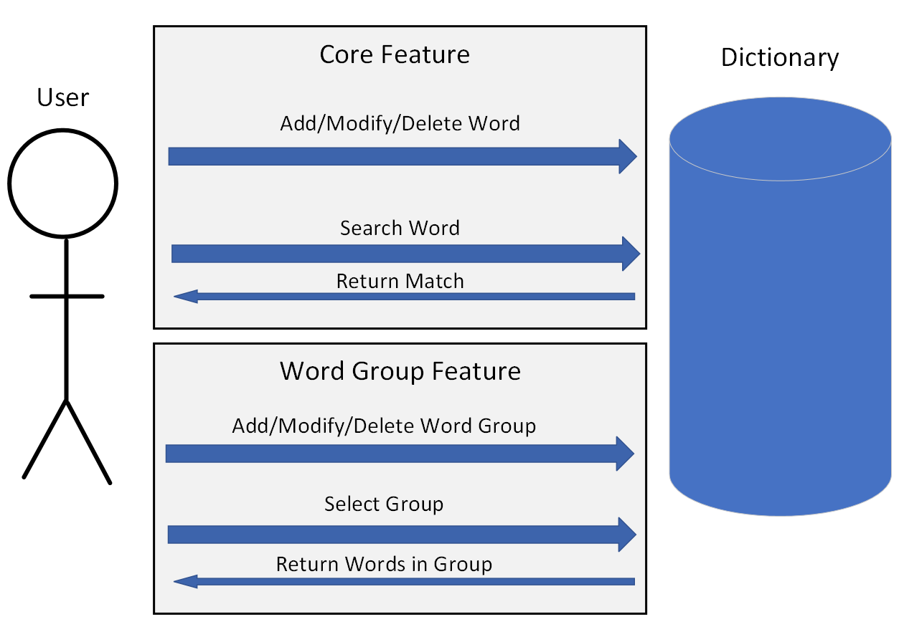
Diagram D0 Basic Functionality

Slide 6
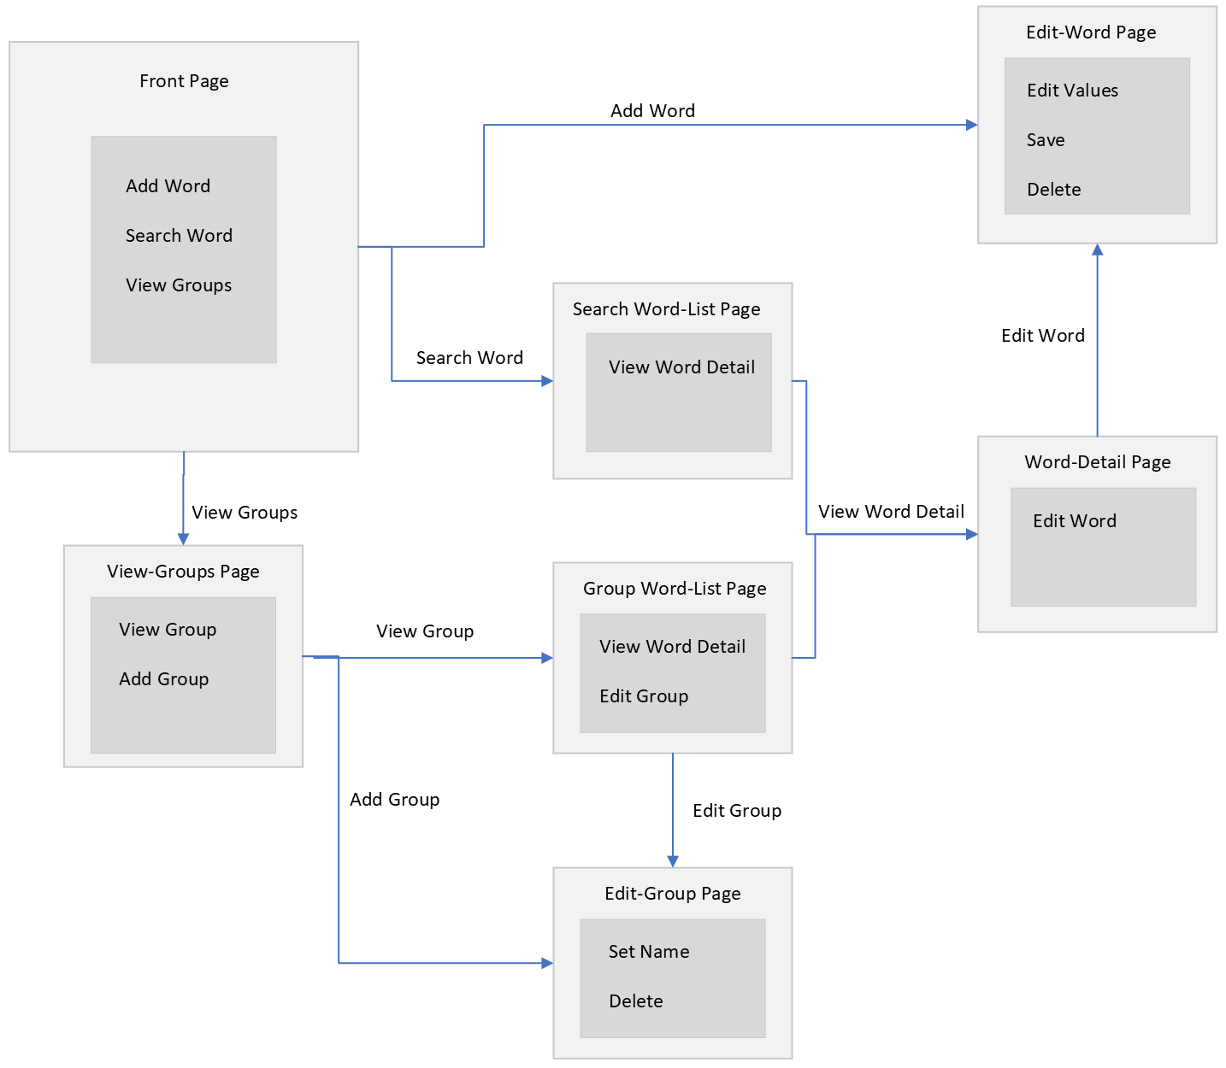
Diagram D1 Page Functionalities & Transitions

Slide 7
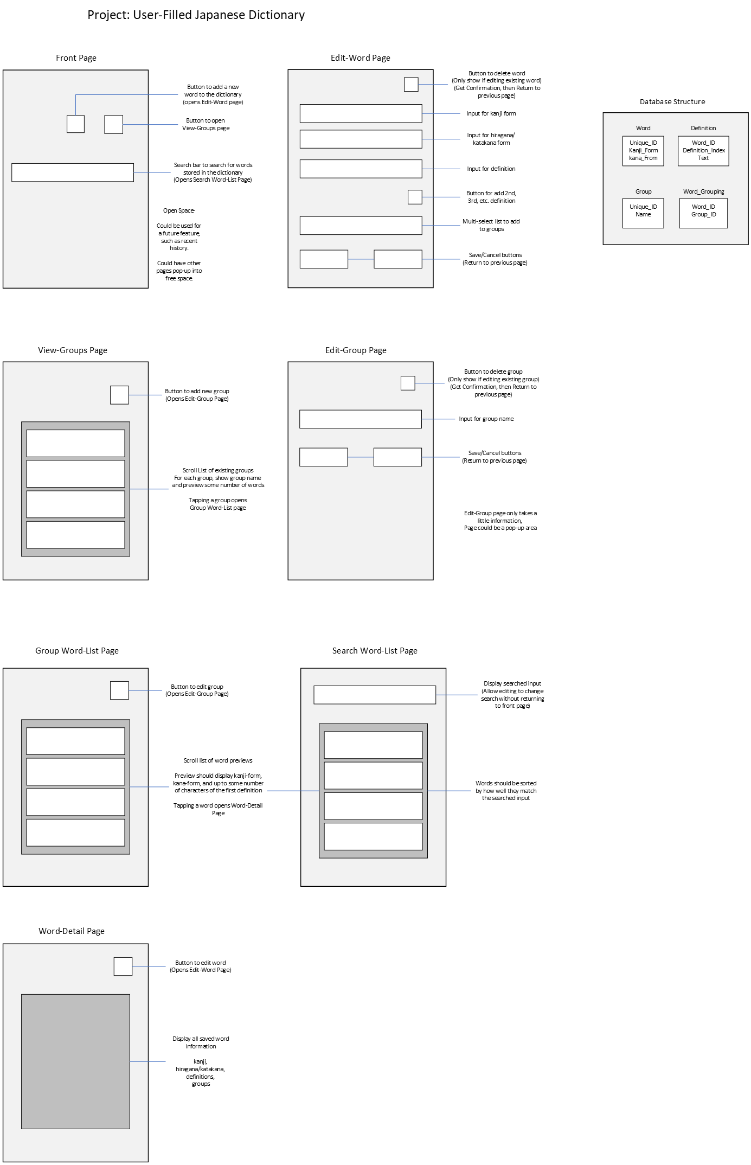
Diagram D2 p1 Page Layouts

Slide 8
Diagram D2 p2 Page Layouts

Slide 9
Diagram D2 p3 Page Layouts

Slide 10
Diagram D2 p4 Page Layouts & Database Structure Draft

Slide 11
Major Constraints
Budget
Freeware only
Time/Manpower
Solo development restricts the scope of the project
Out-of-scope potential features: word conjugation, individual kanji
Character Encoding
Japanese character set must use variable-width characters
Font restrictions
Notes:
5) Major Project Constraints

Slide 12
Current Progress
Planning
The high-level functionalities & layout of the application are planned
Development Environment Set Up
Verified that debug messages can be received from Android phone
Successfully displays input Japanese characters
Notes:
6) Review of Project Progress

Slide 13
Expected Accomplishments for Fall Term
Create each page in the application
Connect transitions between pages
Implement saving words and groups into database
Notes:
7) Expected Accomplishments for Fall Term

Slide 14
Division of Work
Project is solo
Notes:
8) Division of Work (timeline)

Slide 15
Expected Demo at Expo
Application should have all planned functionality
Saving words and groups
Viewing words in groups
Searching for words by word & by definition
Basic sorting of search results
Ability to edit words and groups
Application should have polish
Appearance
Conflict resolution
Improved search and sort
Notes:
9) Expected Demo at Expo

